Slide 1
1. potato_chips.xlsx
2. FST 117_2025_Jelly Bean_Dataset_Long_week3.xlsx

Slide 2
Week 3: t-test
FST 117 Fall 2025
Linli Zhu

Slide 3
HW1 grading
Q1: what’s the probability…
You need to run binomial test here instead of simply divide correct/total
Partial credit if you are close
Please use scientific notation together with rounding decimal places!
Our goal here is to communicate your results

Slide 4
t-test variations
1 sample | Comparison with a reference value Is this temperature higher than 98°F? Is this Brix different than 20%? | Z-score t-test
2 samples | Related samples Each panelist evaluates Products A and B Panelists evaluate Product A in two different conditions (ex: blind vs. branded; white light vs. red light) | Related sample t-test
 | Independent samples One group of volunteers receives a drug, another group receives a placebo One group of consumers evaluates Product A, another group of consumers evaluates Product B | Unrelated sample t-test
Notes:
2 decision you need here

Slide 5
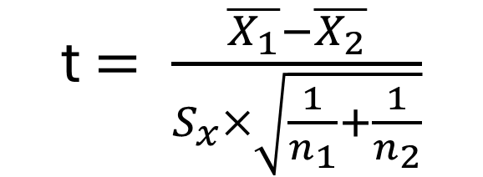
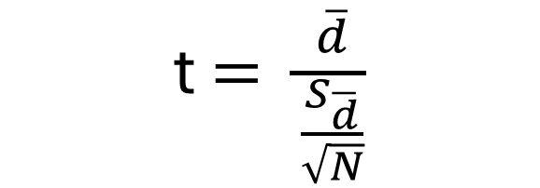
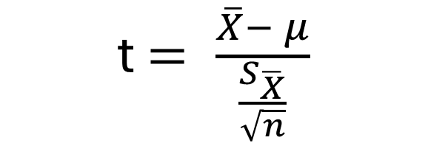
t-statistic equation
t $= \frac{\overline{X}− μ}{\frac{S_{\overline{X}}}{\sqrt{n}}}$
One sample
t $= \frac{\overline{d}}{\frac{S_{\overline{d}}}{\sqrt{N}}}$
Two sample related
t $= \frac{\overline{X_{1}}−\overline{X_{2}}}{S_{x}×\sqrt{\frac{1}{n_{1}}+\frac{1}{n_{2}}}}$
Pooled standard error to account for dispersion of 2 groups!!
Two sample unrelated

Slide 6
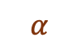
t-test variations
One-tailed t-test:
Before running the experiment, you already know that the mean can only go one direction.
For example, if the value can only be larger:
$$α$$
-3
-2
-1
0
1
2
3
H₀ accepted
H₀ rejected

Slide 7
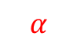
t-test variations
One-tailed t-test:
Before running the experiment, you already know that the mean can only be smaller than the other.
$$α$$
-3
-2
-1
0
1
2
3
H₀ rejected
H₀ accepted

Slide 8
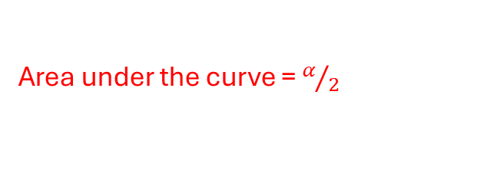
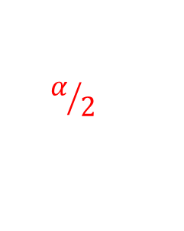
t-test variations
Two-tailed t-test:
Before running the experiment, you know that the mean can be either larger or smaller than the other mean.
Area under the curve = $α/2$
$$α/2$$
-3
-2
-1
0
1
2
3
H₀ rejected
H₀ accepted
H₀ rejected

Slide 9
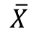
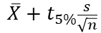
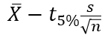
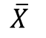
What’s your axis?
0.3
0.2
Axis of t-statistics
0.1
0
- critical t
+ critical t
$$\overline{X}$$
Axis of your original data scale
95% confidence interval
$$\overline{X}−t_{5\%}\frac{s}{\sqrt{n}}$$
$$\overline{X}$$
$$\overline{X}+t_{5\%}\frac{s}{\sqrt{n}}$$
Notes:
Centered at 0 so difference

Slide 10
t-test variations
3 questions to determine:
How many samples do you have? 1 sample or 2 samples?
If 2 samples, is your sample evaluated by the same group of evaluators or 2 groups of evaluators?
Do you know the direction of your analysis before running the study?
By this time, you can tell yourself:
i.e, two-sample two-tailed t-test + your pre-determined alpha!

Slide 11
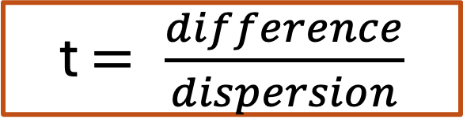
Making your decision – 2 approaches
The RATIO between difference and dispersion
Aka. a scaled difference/ standardized difference
Use t to connect to your probability!
t $= \frac{difference}{dispersion}$
A. Compare your critical t-stat against calculated t-stat
B. De-standardize critical t-stat with SE and put it back onto the original scale and find your confidence interval

Slide 12
Compare your critical t and calculated t
Compare your critical t-stat against calculated t-stat
Aka. You are comparing 2 RATIOs
Step 1:
Determine your critical t-stat from your study:
Type of t-test
One-tailed or two-tailed
Degrees of freedom

Slide 13
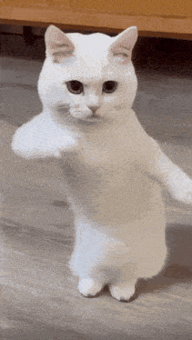
Compare your critical t and calculated t
A. Compare your critical t-stat against calculated t-stat
Step 2:
Calculate your t-stat base on type of t-test you have
Manually calculated in the old days…
RStudio will do the calculation for us! Yayyyyyy!!!!

Slide 14
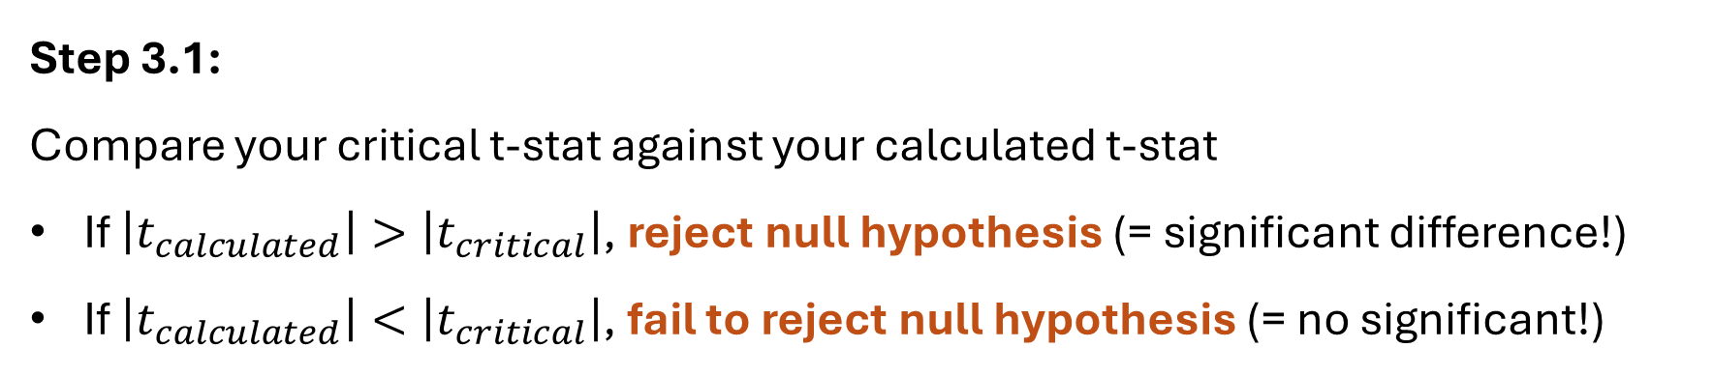
Compare your critical t and calculated t
A. Compare your critical t-stat against calculated t-stat
Step 3.1:
Compare your critical t-stat against your calculated t-stat
If $\left|t_{calculated}\right|>\left|t_{critical}\right|$, reject null hypothesis (= significant difference!)
If $\left|t_{calculated}\right|<\left|t_{critical}\right|$, fail to reject null hypothesis (= no significant!)

Slide 15
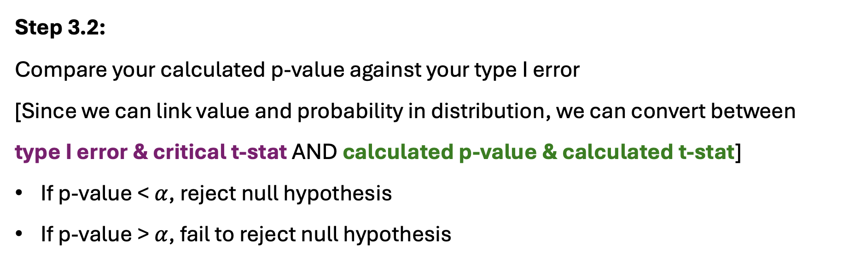
Compare your critical t and calculated t
A. Compare your critical t-stat against calculated t-stat
Step 3.2:
Compare your calculated p-value against your type I error
[Since we can link value and probability in distribution, we can convert between
type I error & critical t-stat AND calculated p-value & calculated t-stat]
If p-value < $α$, reject null hypothesis
If p-value > $α$, fail to reject null hypothesis

Slide 16
Compare mean and compare with C.I.
B. De-standardize critical t-stat with SE and find your confidence interval
Aka. You are comparing on your original ratio
Step 1:
Determine your critical t-stat from your study:
Type of t-test
One-tailed or two-tailed
Degrees of freedom

Slide 17
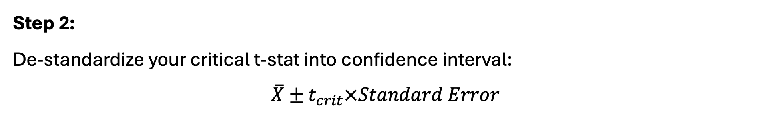
Compare your alpha and calculated p-value
B. De-standardize critical t-stat with SE and put it back onto the original scale and find your confidence interval
Step 2:
De-standardize your critical t-stat into confidence interval:
$\overline{X}±t_{crit}×Standard Error$

Slide 18
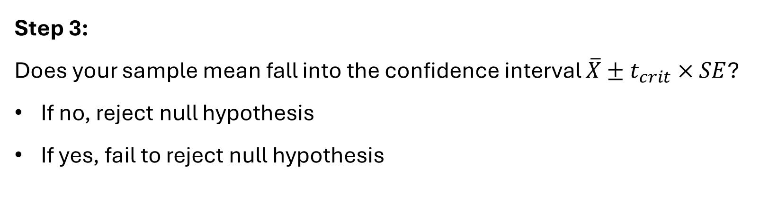
Compare your alpha and calculated p-value
B. De-standardize critical t-stat with SE and put it back onto the original scale and find your confidence interval
This part will change based on your null hypothesis!!!
Step 3:
Does your sample mean fall into the confidence interval $\overline{X}±t_{crit}×SE$?
If no, reject null hypothesis
If yes, fail to reject null hypothesis

Slide 19
t-test in R
t.test(
arguments_identying_your_data_based_on_t_test_type, # 1- or 2-sample
paired = FALSE/TRUE, # if 2-samples, related or unrelated?
alternative = c("two.sided", "less", "greater"), # one- or two-tailed? Direction?
var.equal = FALSE # assume equal variance in this class
)

Slide 20
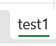
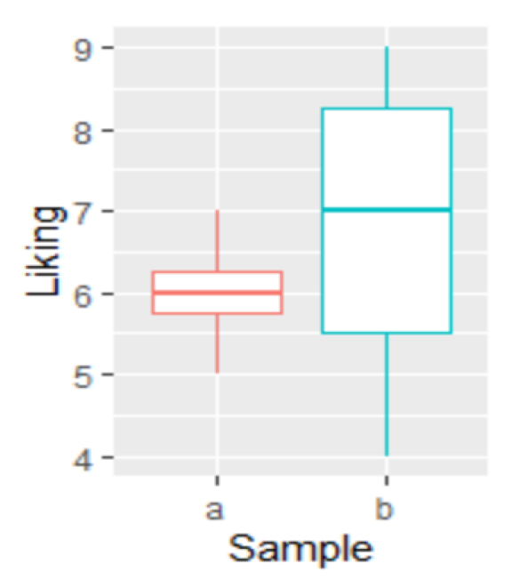
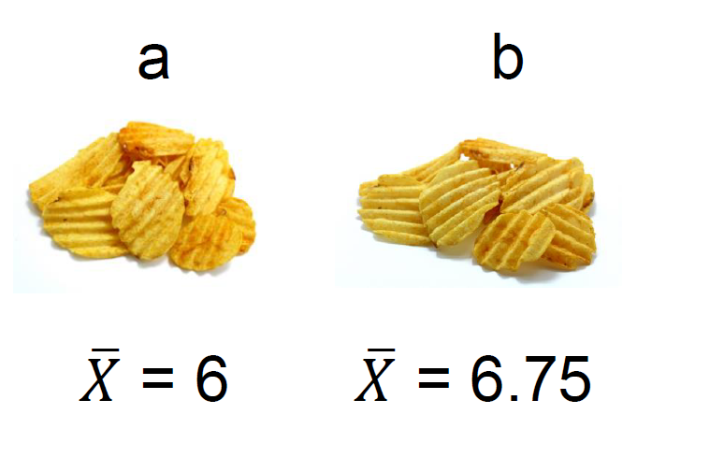

Potato chips – scenario 1
2-sample
Related/ paired
Liking score -> one-tailed or two-tailed?

Slide 21
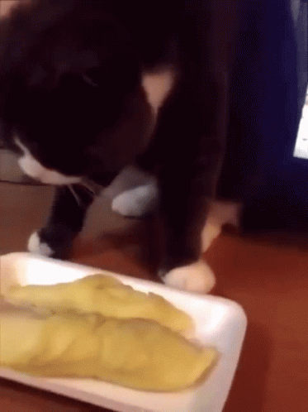
Potato chips – scenario 1
Liking is ALWAYS two-tailed !!!
Something you dislike might be enjoyed by someone else!!
i.e., durian

Slide 22
Potato chips – scenario 1
H₀: ?
H₁: ?

Slide 23
Potato chips – scenario 1
H₀: there is no significant difference between chip A liking and chip B liking
H₁: there is a significant difference between chip A liking and chip B liking

Slide 24
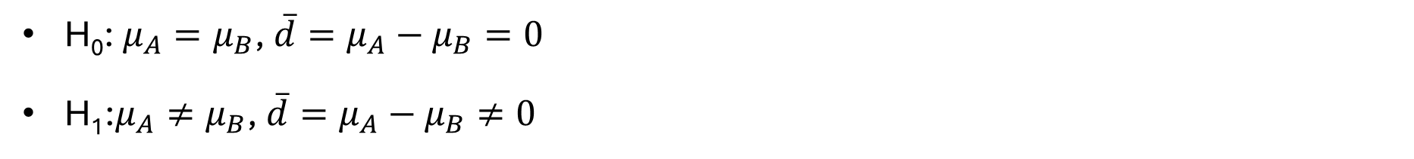
Potato chips – scenario 1
H₀: $μ_{A}=μ_{B}$, $\overline{d}=μ_{A}−μ_{B}=0$
H₁:$μ_{A}≠μ_{B}$, $\overline{d}=μ_{A}−μ_{B}≠0$

Slide 25
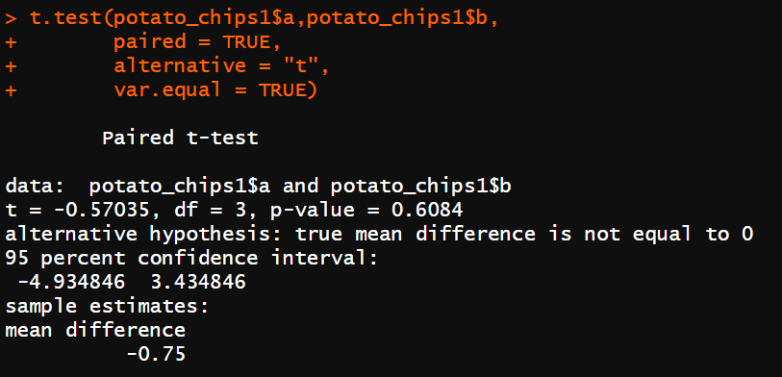
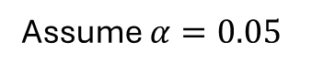
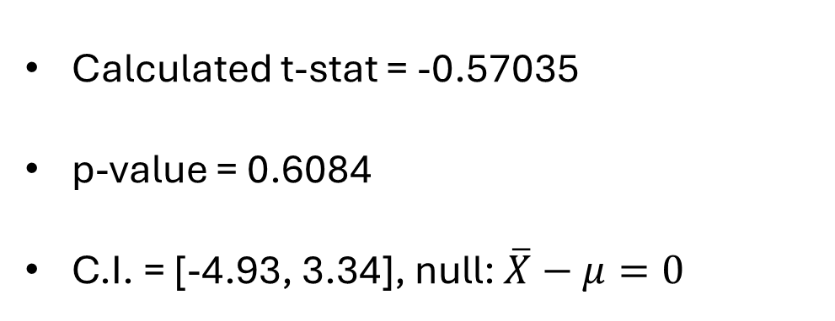
Potato chips – scenario 1
Assume $α=0.05$
A way to better understand:
you are considering one of the condition as a “reference” (but it’s not an actual reference like what you have in one-sample t-test!)
Calculated t-stat = -0.57035
p-value = 0.6084
C.I. = [-4.93, 3.34], null: $\overline{X}−μ=0$
Notes:
“set 1 condition as “reference””

Slide 26
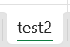
Potato chips – scenario 2
Reference, saltiness = 8
Re-formulated, saltiness = ?
n= 74
One-sample because we are comparing sample against a given reference
Less salt added?
More salt added?
Or I just know there is a formula change happening?
Notes:
Liking is always 2-tailed
One-tailed: bout design, but very rare

Slide 27
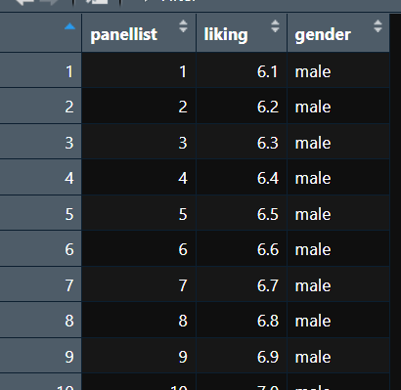
Potato chips – scenario 2
Assume this is liking for re-formulated only
n= 74
Reference = 8
Re-formulated

Slide 28
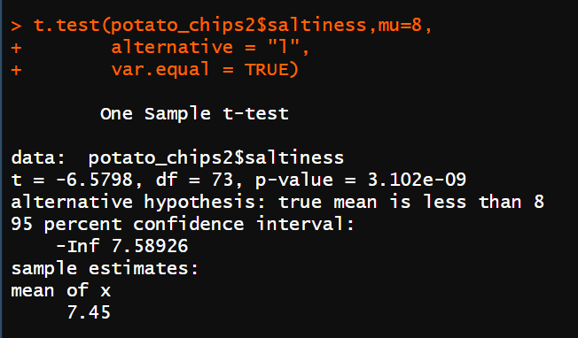
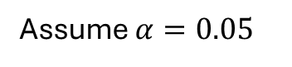
Potato chips – scenario 2
Ref = 8
Less salt
Assume $α=0.05$
Calculated t-stat = -6.5798
p-value = 3.102e-09
C.I. = [-Inf, 7.58], ref = 8

Slide 29
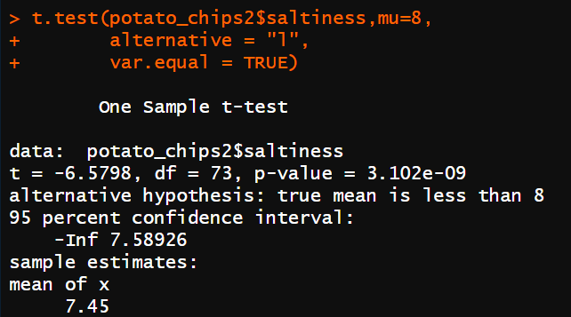
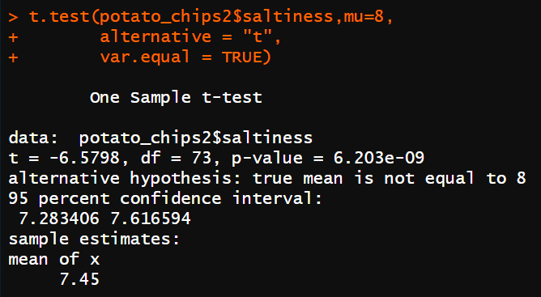
Potato chips – scenario 2
One-tailed to two-tailed, calculated p-value doubled
Because it can be on either side of the distribution
The other way around compared to slicing your alpha!!

Slide 30

Potato chips – scenario 3
A
Liking of chip A?
B
Liking of chip B?

Slide 31
Potato chips – scenario 3
But what if I have 1 chip formula only, and I’m interested in if different gender like this chip differently?
Is this a 1-sample or 2-sample? (hint: how many groups of evaluators we have here?)
If 2-sample, is this related or unrelated?

Slide 32
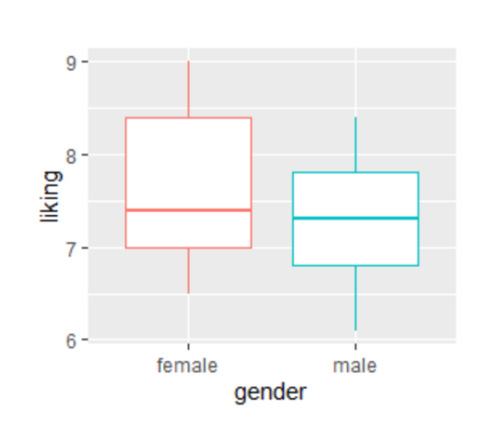
Potato chips – scenario 3
2-sample
Unrelated/ independent because consider dispersion of 2 groups of evaluators
Liking score -> one-tailed or two-tailed?

Slide 33
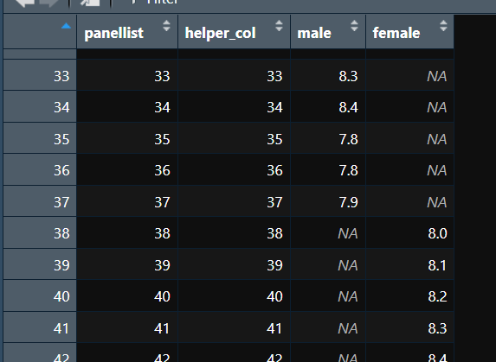
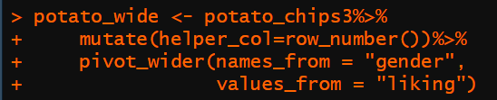
Potato chips – scenario 3

Slide 34
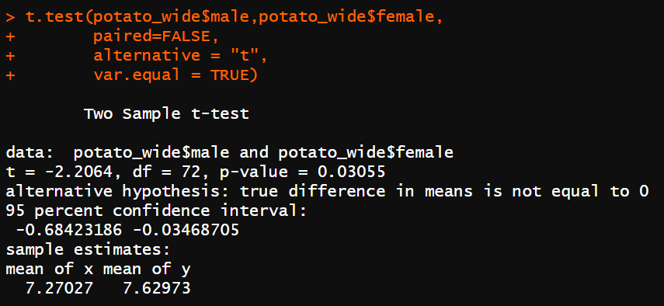
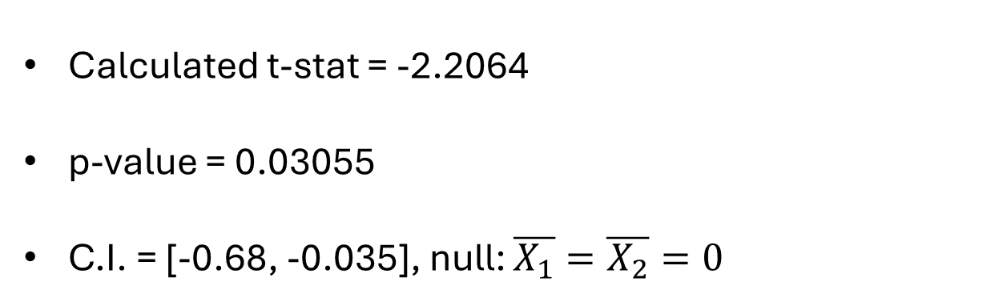
Potato chips – scenario 3
Ref = 8
Less salt
Assume $α=0.05$
Calculated t-stat = -2.2064
p-value = 0.03055
C.I. = [-0.68, -0.035], null: $\overline{X_{1}}=\overline{X_{2}}=0$

Slide 35
Recap
Remember, t-test is comparing means of 2 groups of continuous data
1 sample mean vs 1 population mean
1 condition’s mean vs the other condition’s mean evaluated by same group of people
1 group of evaluator’s mean vs the other group’s of evaluator’s mean

Slide 36
Week 3 HW
Run a t test under three of the following scenarios at 5% significance level
1. Test if the overall liking score of “Mango” significantly differs from “Juicy Pear”
2. Test if the overall liking score of “Sunkist Lime” differs between session1 and session2
3. Test if the mean of the overall liking scores across all flavors all consumers is significantly greater than 5.11
Questions for each scenario:
1. What type of t test should you use? (multiple choice) .25
2. Is this a one-tailed or two-tailed test? (multiple choice) .25
3. What is the calculated t-statistic and p-value? .25
4. Is it significant? .25
Round all answers to 2 decimal places and use scientific notation (e.g., 6.081239 ->6.08; 7.6948e-3 ->7.70e-3)

Slide 37
Week 3 HW
Use data: FST 117_2025_Jelly Bean_Dataset_Long_week3.xlsx
DO NOT USE WEEK 1 DATA BECAUSE IT’S DIFFERENT!!!
This data is in long format
In t-test, are you using long format or wide format?
Some functions might be useful for you in next pages

Slide 38
Week 3 HW
Assume you have a column with label A, B, C, or D
You can filter out the rows containing A or B by using filter() from tidyverse
Df <- filter(old_data_name,
column_name == A |
column_name == B)

Slide 39
Week 3 HW
If you want to pivot long format into wide format
Use pivot_wider() from tidyverse (reverse manipulation of pivot_longer() function)
Df <- old_data %>%
pivot_wider(id_cols = identifying_code_column, # for example your judge
names_from = column_1,
# the labels in this column will be convert into your wide format column names
values_from = column_2
# the values in this column will be your values)

Slide 40
Week 3 HW
Judge | Yogurt_flavor | Liking
1 | Strawberry | 6
1 | Blueberry | 7
2 | Strawberry | 7
2 | Blueberry | 7
3 | Strawberry | 4
3 | Blueberry | 6
4 | Strawberry | 7
4 | Blueberry | 4

Slide 41
Week 3 HW
Yogurt_new <- yogurt_wide %>%
pivot_wider(id_cols = Judge,
names_from = Yogurt_flavor,
# the labels in this column will be convert into your wide format column names
values_from = Liking
# the values in this column will be your values)

Slide 42
Week 3 HW
Judge | Strawberry | Blueberry
1 | 6 | 7
2 | 7 | 7
3 | 4 | 6
4 | 7 | 4

Slide 43
Special HW instruction

